Slide 1
Sunny Socks Website
Presentation by: Aynur T., Réka Sz-K., Group E

Slide 2


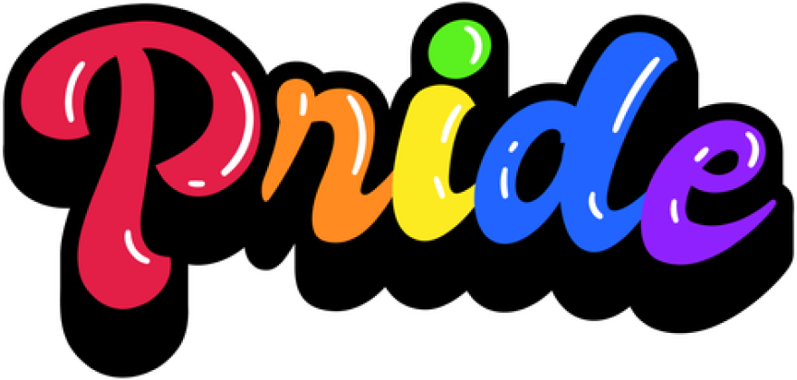
Sunny Socks — Keywords
Positivity >> core values
Colourfulness >> display of brand colours
Fairness >> sustainability-related values
Inclusivity >> Pride page showcasing Sunny Socks’ support

Slide 3
[Demo]

Slide 4
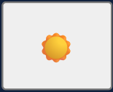
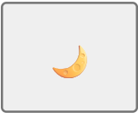

Sunny Socks — Key features
Light/Dark mode toggle
Chatbot
Dynamic design based on time/day
/

Slide 5
Thank you for your time!

